Slide 1
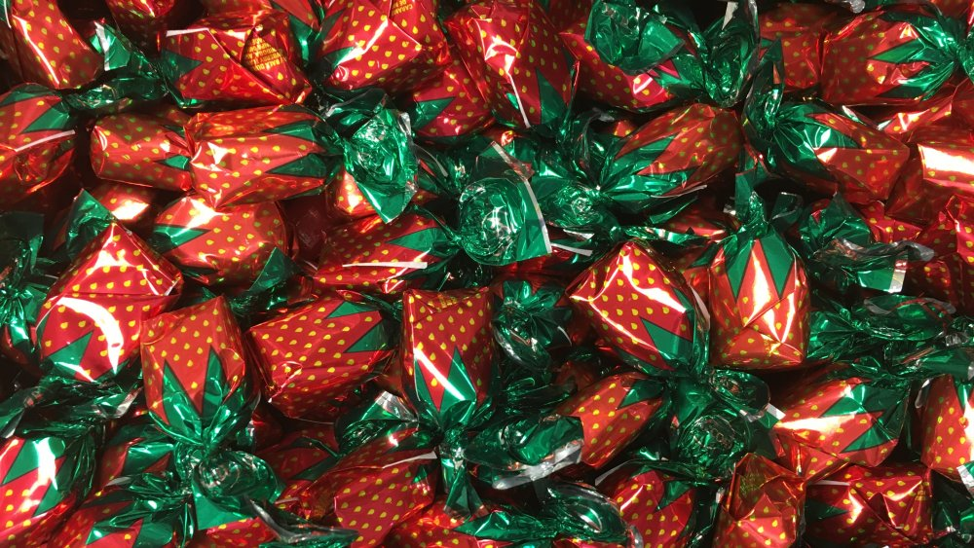
Reward Capture Literature Review
Jonathan Yuquimpo

Slide 2
How reward impacts cognition
Reward
Attention
Visual Working Memory

Slide 3
“Goal Driven”
Top Down
How reward impacts cognition
Value-Driven Attentional
Capture (VDAC)
Evidence VDAC may impact memory
1st year project!
Bottom Up
“Stimulus Driven”

Slide 4

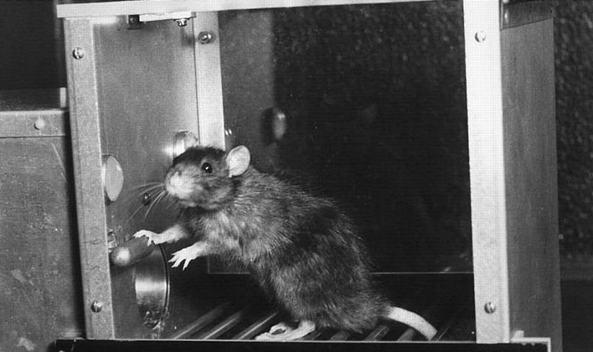

Slide 5
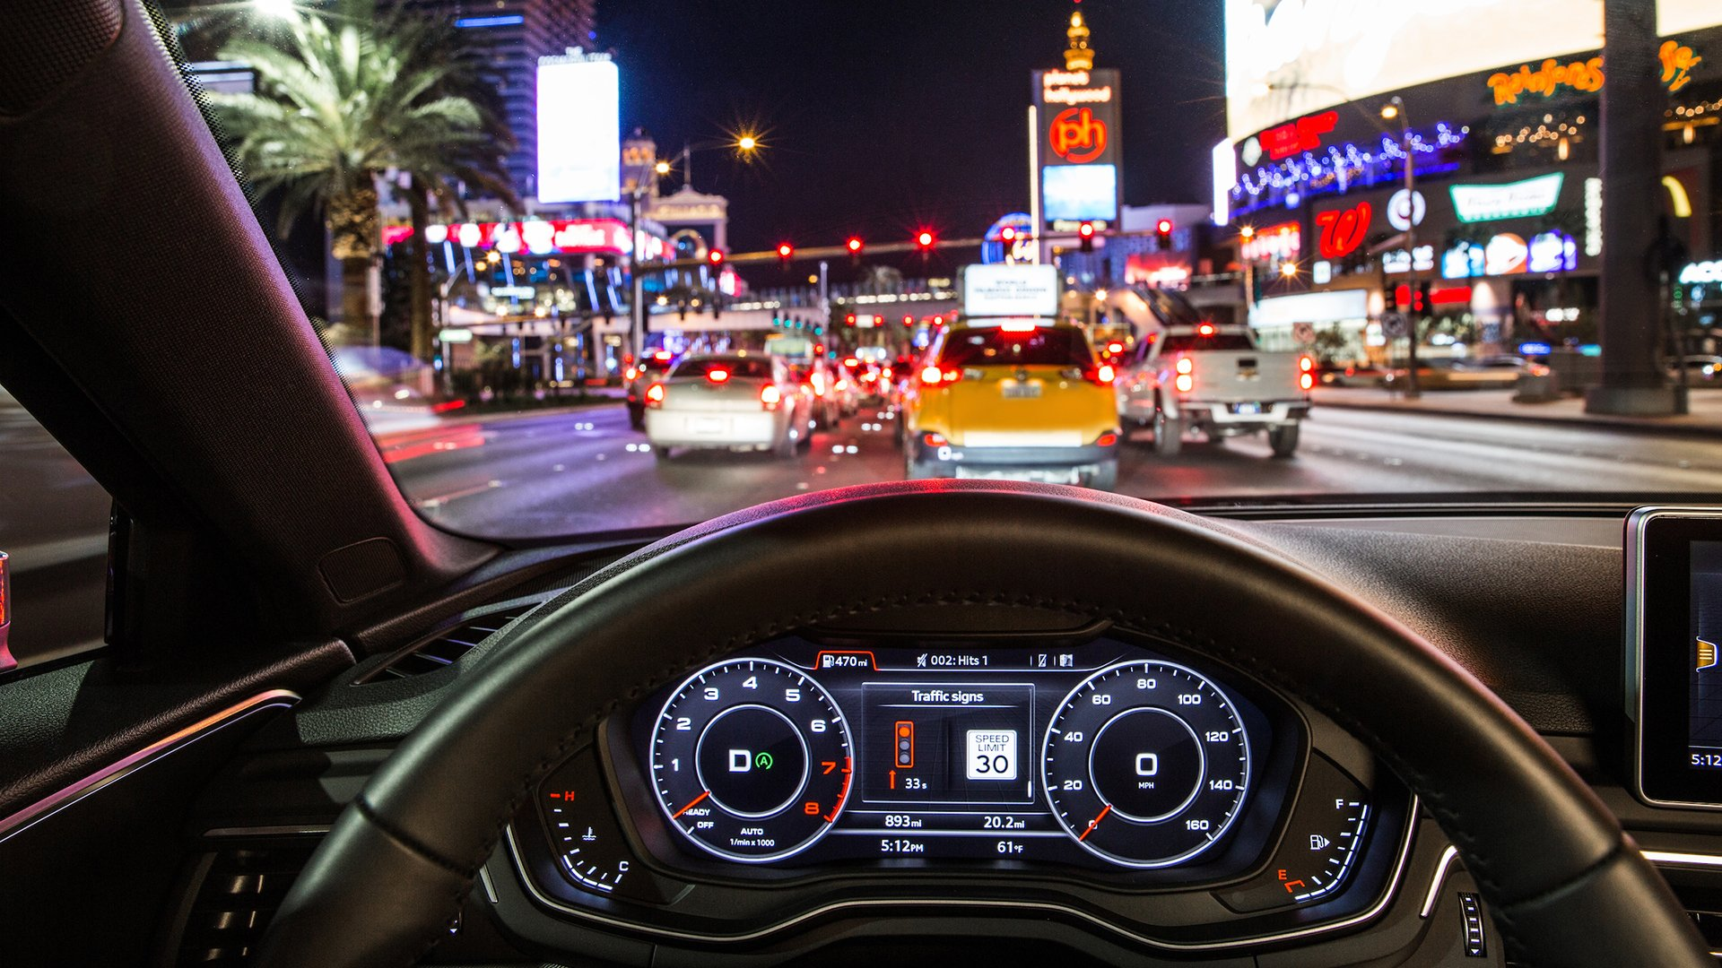

Slide 6


Slide 8
Observer
Goals
Selection History &
Reward
Stimulus
Salience

Slide 9
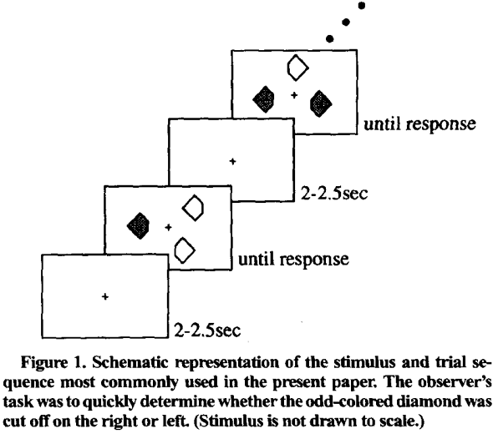
Green Target
Red Target
Right Cut Off
Left Cut Off
Priming of pop-out: I. Role of features
Maljkovic & Nakayama, 1994
Notes:
Three singleton presented simultaneously
Physical singleton – shape, location
Make judgement about that singleton
If singleton is colored, expect better performance for high- color than low –color
If singleton is not colored but in the presence of high- color, expect lower performance

Slide 10
Hypotheses
Stimulus Expectancy
Priming
P(Color Switch)
0
0.5
1
Response Time
0 0.5 1
0 0.5 1
P(Color Switch)
Priming of pop-out: I. Role of features
Maljkovic & Nakayama, 1994
Notes:
Three singleton presented simultaneously
Physical singleton – shape, location
Make judgement about that singleton
If singleton is colored, expect better performance for high- color than low –color
If singleton is not colored but in the presence of high- color, expect lower performance

Slide 11
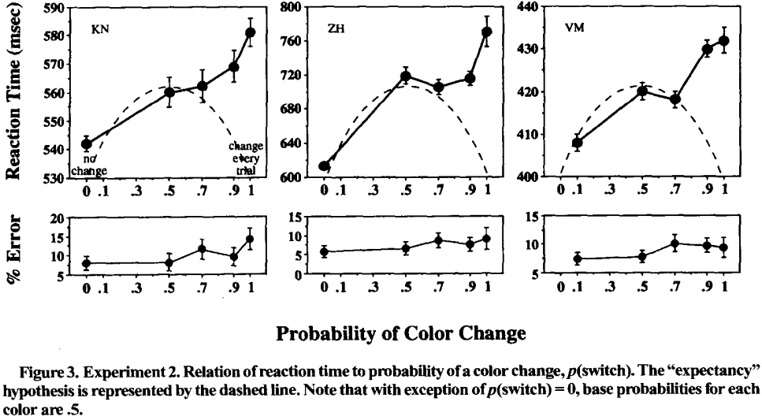
Priming of pop-out: I. Role of features
Maljkovic & Nakayama, 1994
Notes:
Emphasize automatic process

Slide 12
Summary so Far
Prior selection of stimulus features automatically enhances search for those features despite an observer’s goals

Slide 13

Learning Phase
Test Phase
+ $0.05
$10.05 total
1500 ms
Correct
1000 ms
1000 ms
1000 ms or until response
1500 ms or until response
400 – 600 ms
400 – 600 ms
Learned value magnifies salience-based attentional capture
Anderson et al., 2011

Slide 14
Learning Phase
Horizontal Target
Vertical Target
+ $0.05
$10.05 total
1500 ms
High Value Color:
80%: 5¢
20%: 1¢
High Value Color:
20%: 5¢
80%: 1¢
1000 ms
1000 ms or until response
400 – 600 ms
Learned value magnifies salience-based attentional capture
Anderson et al., 2011

Slide 15
Test Phase
Horizontal Target
Vertical Target
Correct
High Value Distractors
Low Value Distractors
1000 ms
1500 ms or until response
400 – 600 ms
Learned value magnifies salience-based attentional capture
Anderson et al., 2011
Notes:
Attention to attention task – Anderson
Memory task – sandry
Attention to memory task – Us
( possible addition – attention to memory is not guaranteed
We’ve seen attention capture transfer to attention task, and we’ve seen reward directly influence memory task, yet a more interesting topic would be transfer from an attention task to a memory task. Attention is incredible relevant to memory, yet enhanced attention does not nessessarily equate to better memory.

Slide 16
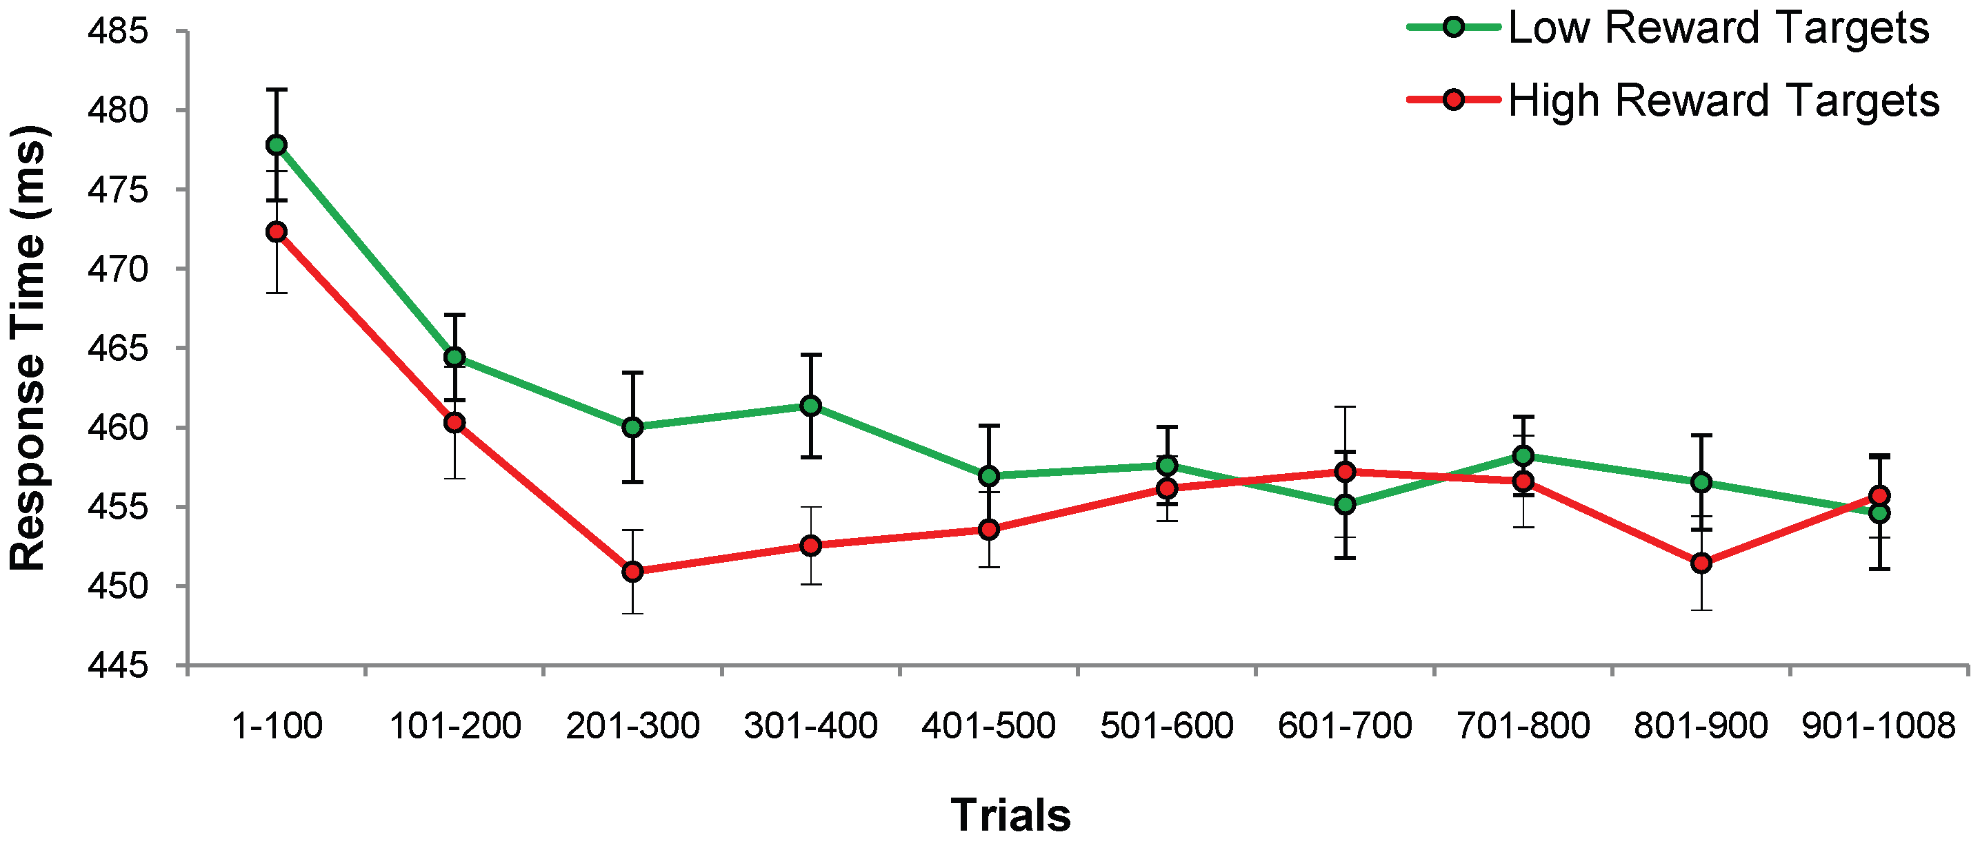
Training Phase: Lower RT for High Reward Targets
n = 18
Anderson et al., 2011

Slide 17
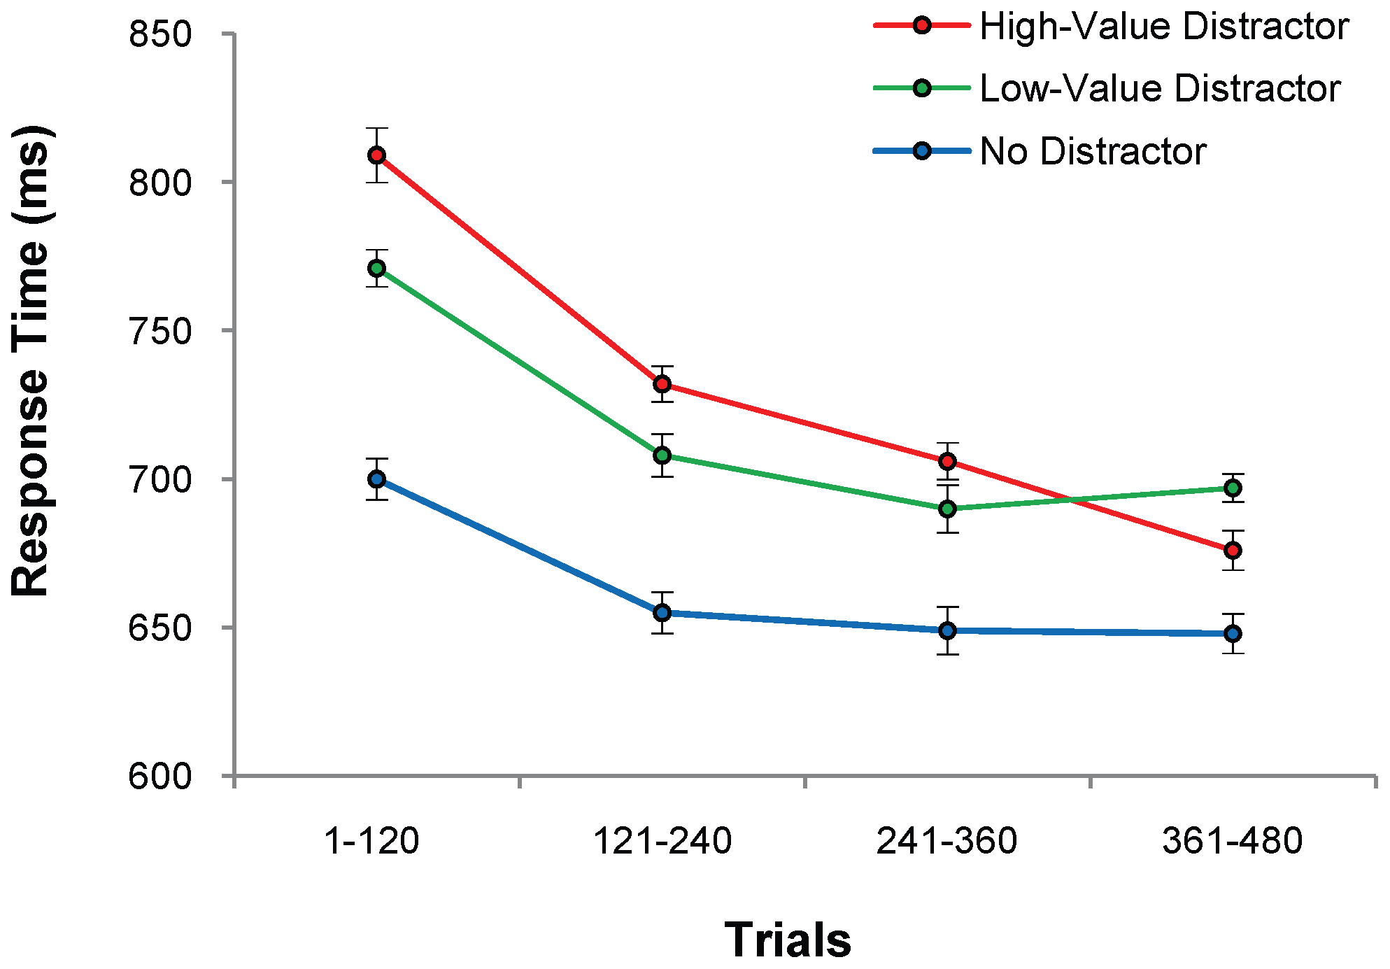
Test Phase: Higher RT for Previously Rewarded Distractors
High-Value: 728 (3.8)
Low-Value: 710 (3.9)
No Distractor: 655 (5.5)
n = 18
Anderson et al., 2011

Slide 18
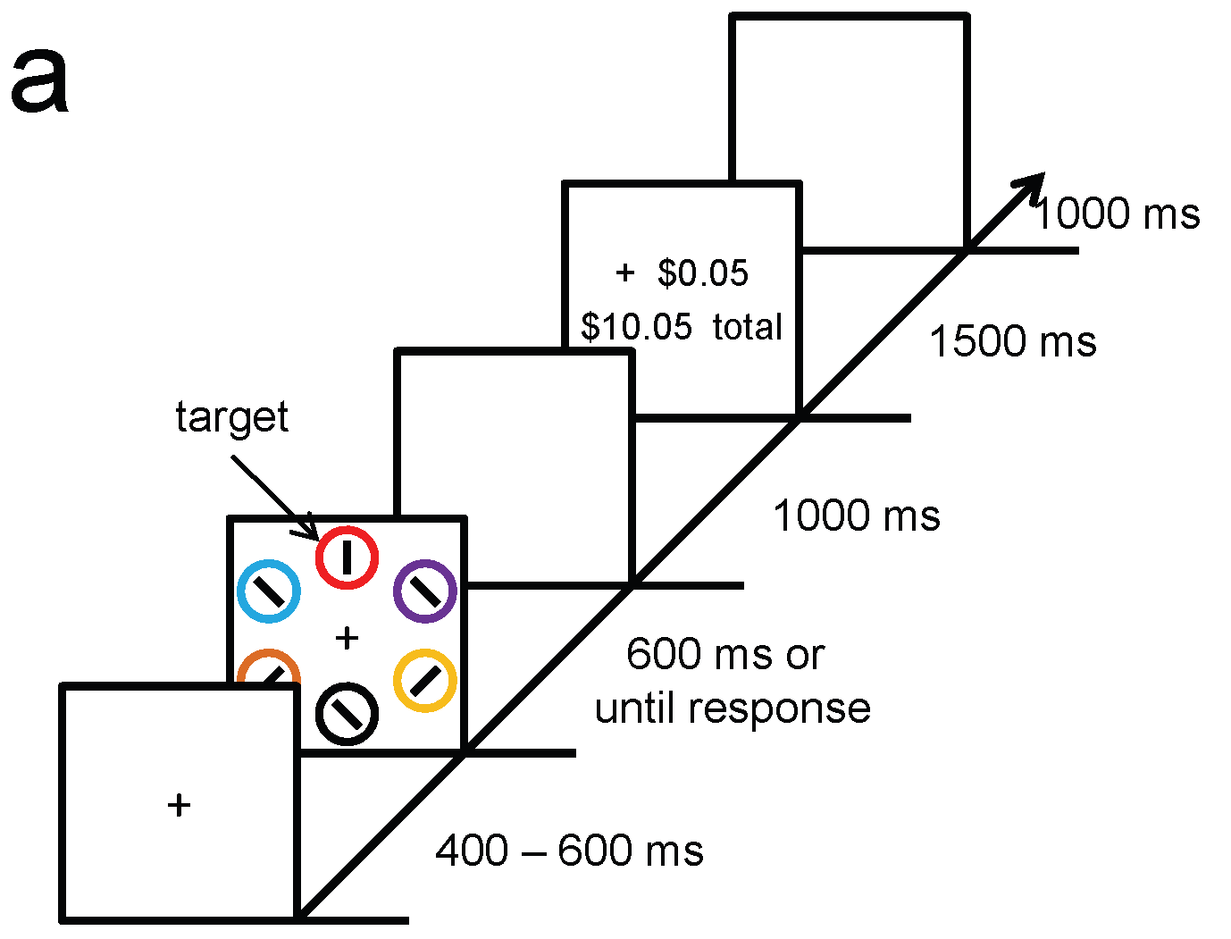
Experiment 2: Isolating Effects of Selection History
Red Targets
Green non-target
No reward feedback given
Compensation based on flat rate
Test phase was kept the same
Anderson et al., 2011

Slide 19
Correct
Horizontal Target
Vertical Target
Learning Phase
Target Colored Distractors
Non-Target Colored Distractors
Correct
Test Phase
Anderson et al., 2011

Slide 20
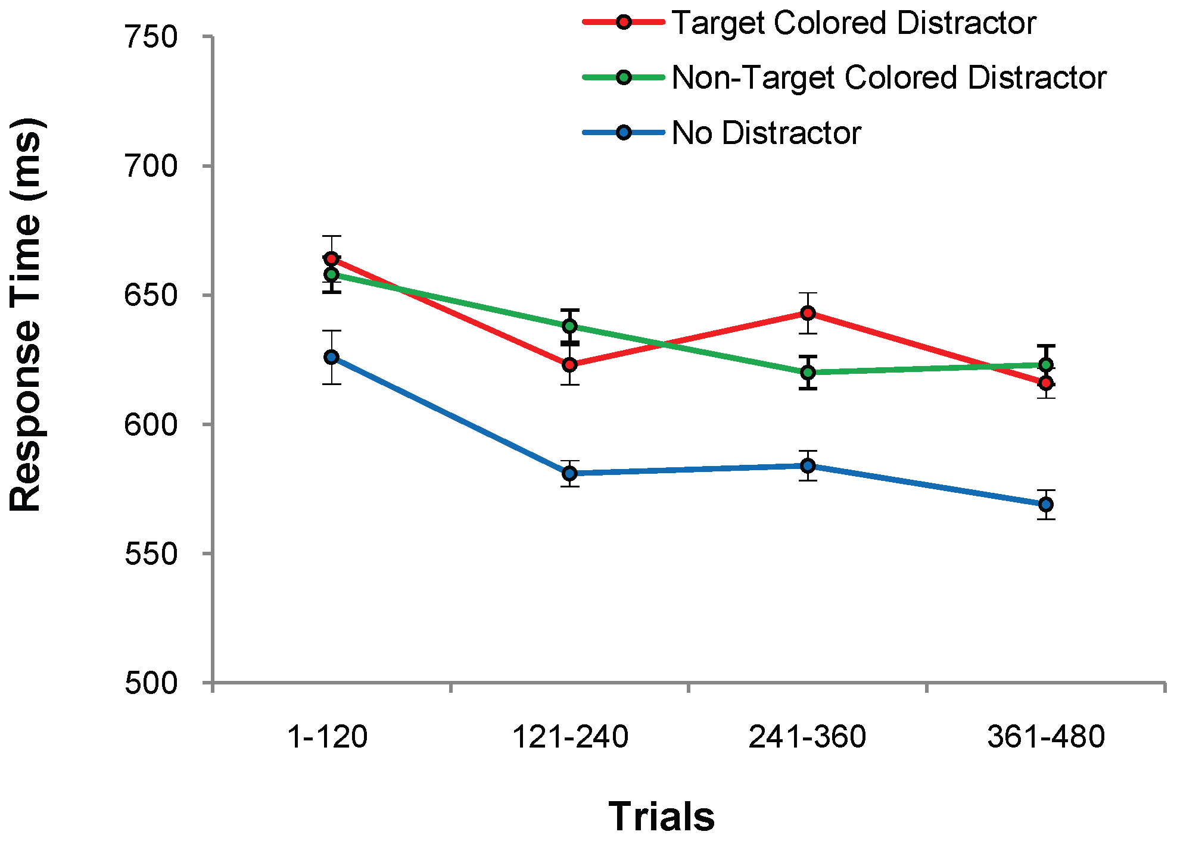
Test Phase 2: No Differences Between Distractor Conditions
Target: 634 (4.8)
Non-target: 632 (4.1)
No Distractor 588 (6.3)
n = 18
Anderson et al., 2011

Slide 21
Rewarded Distractors Resulted in Higher RT
Experiment 1:
Monetary Feedback
High Reward: 728 (3.8)
Low Reward: 710 (3.9)
No Distractor: 655 (5.5)
Shows effect of reward
Experiment 2:
Correct/Incorrect Feedback
Target Distractor: 634 (4.8)
Non-target Distractor: 632 (4.1)
No Distractor: 588 (3.6)
Shows effect of only selection history
Anderson et al., 2011

Slide 22
Summary so Far
Prior selection of stimulus features automatically enhances search for those features despite an observer’s goals
Learned value involuntarily biases attention towards reward-associated stimulus features

Slide 23
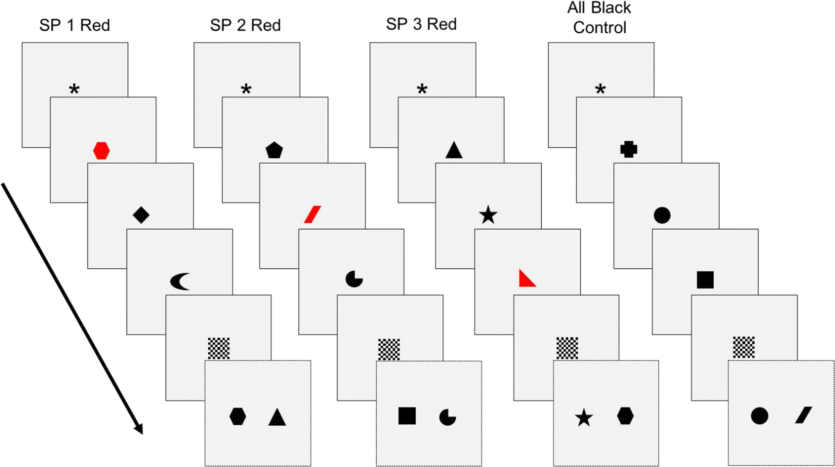
Recognition Task
3 list items presented for 0.5 seconds
300 2AFC trials for each between-subjects condition
High-Reward:
Red: 25 points
Black: 3 points
Equal-Reward:
Red: 3 points
Black: 3 Points
Prioritization within visual working memory reflects a flexible focus of attention
Sandry & Ricker, 2020
Notes:
Start with Anderson, then sandry, introduce Gong and Li, signal detection theory, then re-apply signal detection theory to Sandry and Gong and Li (show how gong found some trends in criterion)

Slide 24
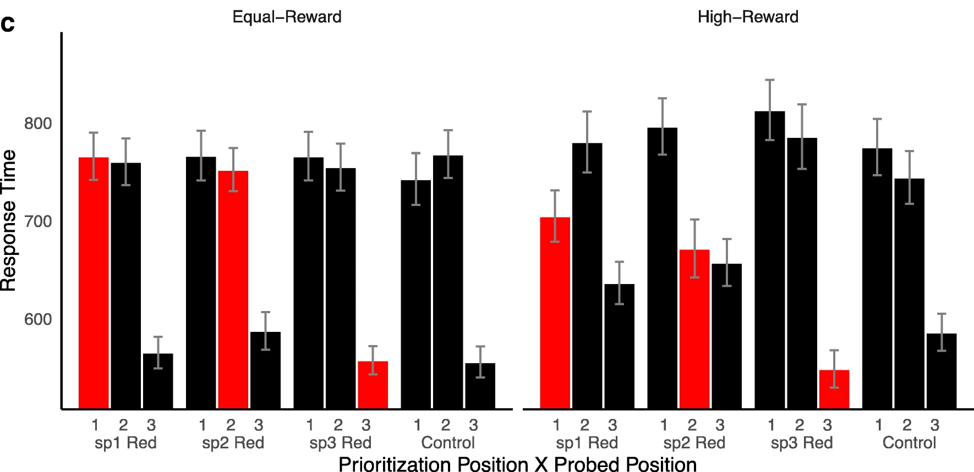
Description of Results

Slide 25
1st item
2nd item
3rd item
Test Item
--Mask--

Slide 26
1st item
2nd item
3rd item
Test Item
--Mask--

Slide 27
1st item
2nd item
3rd item
Test Item
--Mask--

Slide 28
1st item
2nd item
3rd item
Test Item
--Mask--

Slide 29
1st item
2nd item
3rd item
Test Item
--Mask--

Slide 30
1st item
2nd item
3rd item
Test Item
--Mask--

Slide 31
1st item
2nd item
3rd item
Test Item
--Mask--

Slide 32
1st item
2nd item
3rd item
Test Item
--Mask--

Slide 33
1st item
2nd item
3rd item
Test Item
--Mask--

Slide 34
1st item
2nd item
3rd item
Test Item
--Mask--

Slide 35
1st item
2nd item
3rd item
Test Item
--Mask--

Slide 36
Effect of High-Reward on Response Time

Slide 37
Effect of High-Reward on Response Time

Slide 38
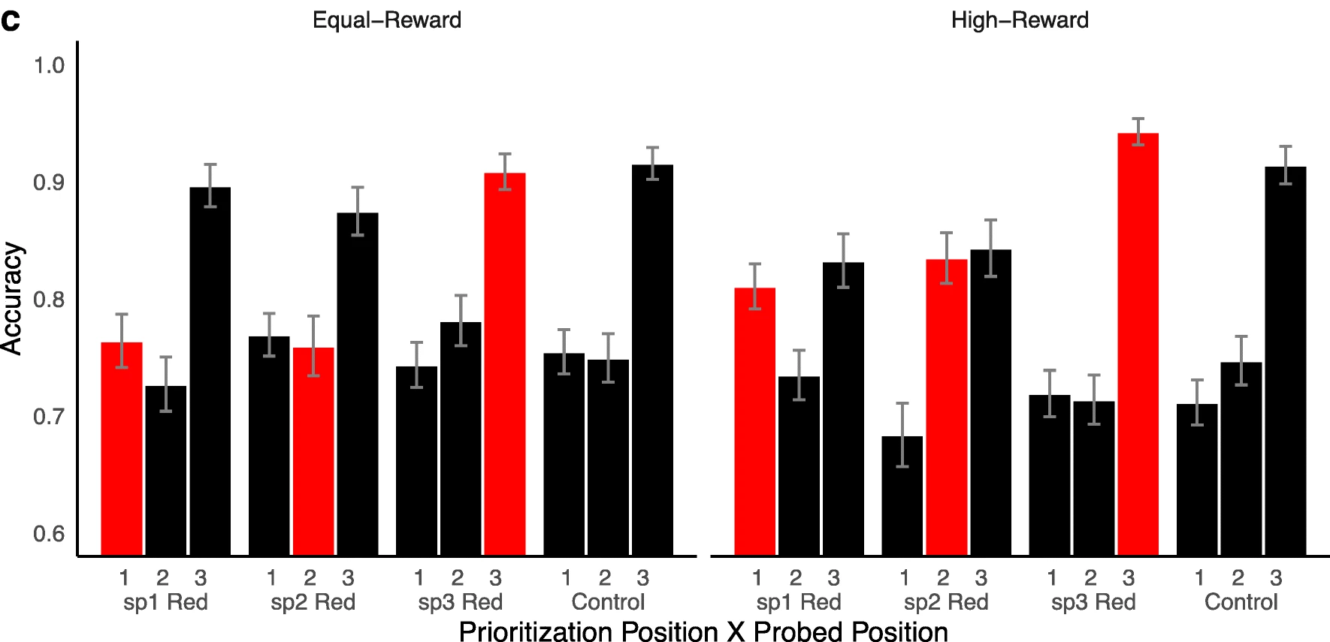
Effect of Reward on Accuracy

Slide 39
Effect of Reward on Accuracy

Slide 40
Summary so Far
Prior selection of stimulus features automatically enhances search for those features despite an observer’s goals
Learned value involuntarily biases attention towards reward-associated stimulus features
Reward shifts attentional resources to enhance working memory of reward-associated items
Notes:
Reward and selection can make stimuli more salient despite an observer’s top-down goals.
Altogether, it seems as though reward and selection history can enhance a stimuli’s saliency despite an observer’s goals, and without changing the physical nature of the stimuli.
Sandry & Ricker’s study does not show if the attentional effects of rewarded stimuli automatically transfer over to a memory task
The use of 2AFC prevents discriminability and criterion analyses

Slide 41
Pre-Test Phase
432 Change blindness trials (216 red, 216 green)
Target indicated by probe line
Each line has an equal chance of being probed
1000 - 2500 ms
500 ms
400 – 600 ms

Slide 42
Pre-Test Phase
Learning Phase
+ ¥0.5
Total: ¥2
1500 ms
1000 - 2500 ms
1000 ms
500 ms
500 ms or until response
400 – 600 ms
400 – 600 ms
Notes:
800 Training Trials
Occurs 1 day after Pre-Test Phase

Slide 43
Post-Test Phase
Same task and trial counts as pre-test phase
Tested 1 day after learning phase
Compares high-, low- and no-value colors before and after value training
1500 ms
1000 - 2500 ms
500 ms
400 – 600 ms
Notes:
800 Training Trials
Occurs 1 day after Pre-Test Phase

Slide 44
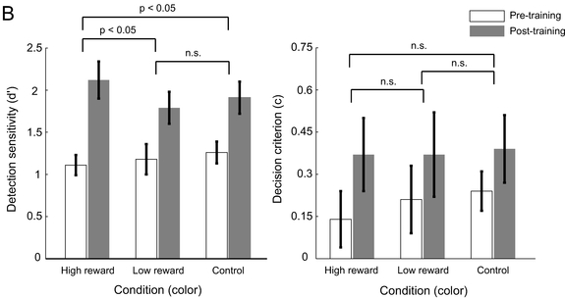
Detection Sensitivity and Response Bias by Reward Condition

Slide 45
Pre/Post-Test Phase
360 change blindness trials
All bars displayed were red, green or grey
Tested 1 day after learning phase
1000 - 2500 ms
500 ms
400 – 600 ms

Slide 46
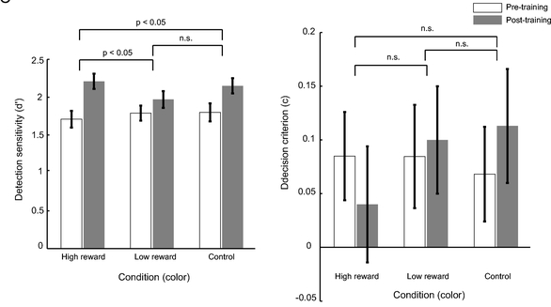
Detection Sensitivity and Response Bias by Reward Condition

Slide 47
Summary so Far
Prior selection of stimulus features automatically enhances search for those features despite an observer’s goals
Learned value involuntarily biases attention towards reward-associated stimulus features
Reward shifts attentional resources to enhance working memory of reward-associated items
Reward-associations may enhance memory capacity with little affect to response bias
Notes:
Reward and selection can make stimuli more salient despite an observer’s top-down goals.
Altogether, it seems as though reward and selection history can enhance a stimuli’s saliency despite an observer’s goals, and without changing the physical nature of the stimuli.
Anderson shows reward affect performance in irrelevant tasks
Sandry shows attention biasing can affect memory
Our study connects these two
NSF
Gong and Li Study here + signal detection
Sandry & Ricker’s study does not show if the attentional effects of rewarded stimuli automatically transfer over to a memory task
The use of 2AFC prevents discriminability and criterion analyses

Slide 48

Learning Phase
Test Phase
A
2500 ms or until response
+ 10 points
42 points total
500 ms
1500 ms
D
500 ms
S
1000 ms
500 ms
1000 ms or until response
A
500 ms
400 – 600 ms
400 – 600 ms

Slide 49
Learning Phase
200 trials (4 blocks of 50)
Money substituted with points
+ 10 points
42 points total
1500 ms
High Value Color:
80%: 10 points
20%: 2 points
Low Value Color:
20%: points
80%: points
1000 ms
1000 ms or until response
400 – 600 ms

Slide 50






List Item
Test Phase
Test Item
High Reward Color
N
A
2500 ms or until response
N
N
500 ms
D
500 ms
Non-Color Hits
S
Color Hits
False Alarms
500 ms
A
500 ms
400 – 600 ms

Slide 51
List Item
Test Phase
Test Item
High Reward Color
N
A
2500 ms or until response
N
N
500 ms
D
500 ms
Non-Color Hits
S
Color Hits
False Alarms
500 ms
A
500 ms
400 – 600 ms

Slide 52
List Item
Test Phase
Test Item
High Reward Color
N
A
2500 ms or until response
N
N
500 ms
D
500 ms
Non-Color Hits
S
Color Hits
False Alarms
500 ms
A
500 ms
400 – 600 ms

Slide 53
List Item
Test Phase
Test Item
High Reward Color
N
A
2500 ms or until response
N
N
500 ms
D
500 ms
Non-Color Hits
S
Color Hits
False Alarms
500 ms
A
500 ms
400 – 600 ms

Slide 54
List Item
Test Phase
Test Item
High Reward Color
N
S
2500 ms or until response
N
N
500 ms
D
500 ms
Non-Color Hits
S
Color Hits
False Alarms
500 ms
A
500 ms
400 – 600 ms

Slide 55
List Item
Test Phase
Test Item
High Reward Color
N
D
2500 ms or until response
N
N
500 ms
D
500 ms
Non-Color Hits
S
Color Hits
False Alarms
500 ms
A
500 ms
400 – 600 ms

Slide 56
List Item
Test Phase
Test Item
High Reward Color
N
G
2500 ms or until response
N
N
500 ms
D
500 ms
Non-Color Hits
S
Color Hits
False Alarms
500 ms
A
500 ms
400 – 600 ms

Slide 57



List Item
Test Phase
Test Item
High Reward Color
N
A
2500 ms or until response
N
N
500 ms
D
Low Reward Color
N
500 ms
S
N
500 ms
A
N
500 ms
400 – 600 ms

Slide 58
List Item
Test Phase
Test Item
High Reward Color
N
A
2500 ms or until response
N
N
500 ms
D
Low Reward Color
N
500 ms
S
N
500 ms
A
N
500 ms
No Color
N
400 – 600 ms

Slide 59
Hypotheses
Effect of reward magnitude on…
Detection Sensitivity | Direct relationship | Higher d’ for higher reward
Response Bias | Inverse relationship | Liberal bias for higher reward
Response Time | Inverse relationship | Faster responses for higher reward
Notes:
Show example graphs of what we expect from the data – greater d-prime for high-reward items

Slide 60
Learning Phase

Slide 61
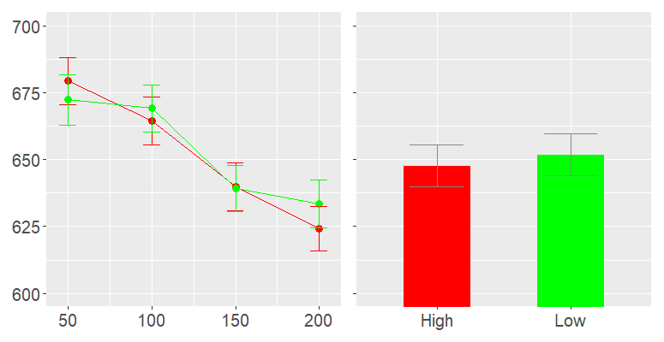


Mean Response Time by Trial Block and Color Value 775 x 400
By Trial Block
By Reward Condition
Effect of…
Reward Condition
Trial Block
Interaction
Response Time
Trials
Reward
Color Value: High Low
Notes:
Potential questions about why there’s no perfomrnace difference – possible due to this being just training
Have t-test and bayes factors

Slide 62
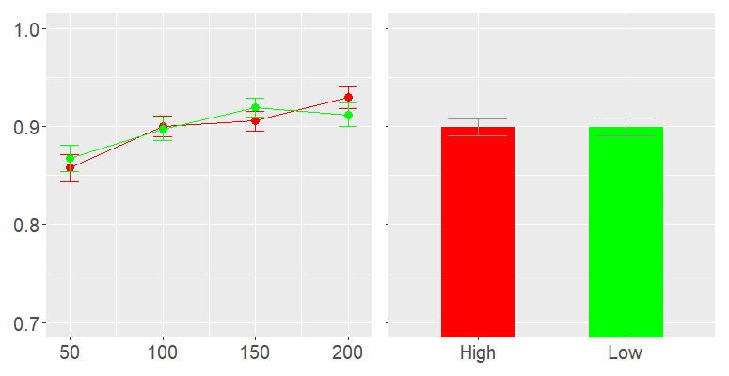
Mean Accuracy by Trial Block and Color Value
By Trial Block
By Reward Condition
Effect of…
Reward Condition
Trial Block
Interaction
Proportion Correct
Trials
Reward
Color Value: High Low

Slide 63
Test Phase

Slide 64
List Item
Data Collapsing
Test Item
High Reward Color
N
High
N
N
Low Reward Color
N
Low
N
N
No Color
Control
N

Slide 65
List Item
Data Collapsing
Test Item
High Reward Color
N
High
N
N
Low Reward Color
N
Low
N
N
No Color
Control
N

Slide 66
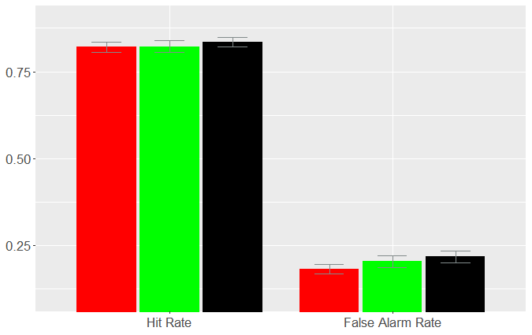
Hit Rate and False Alarm Rate by Color Value
Effect of Reward on…
Hit Rate
False Alarm Rate
Proportion
Response Measure
Color Value: High Low Control
Full Stats Here

Slide 67
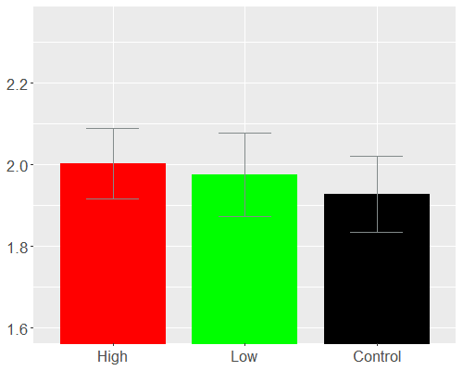
Detection Sensitivity by Color Value 500 x 400
Effect of Reward on…
Discriminability
Criterion
Response Time
Detection Sensitivity (d’)
Reward Condition
Full Stats Here

Slide 68
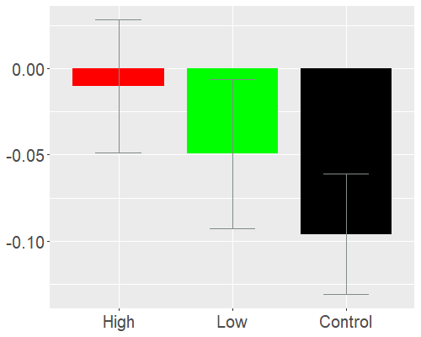
Response Bias by Reward Condition
Effect of Reward on…
Discriminability
Criterion
Response Time
Response Bias (c)
Reward Condition
Full Stats Here

Slide 69
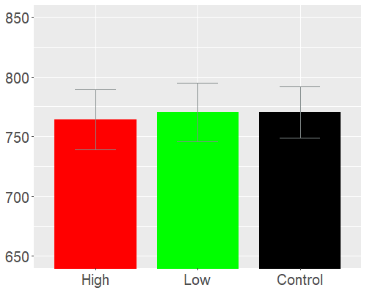
Response Time by Reward Condition
Effect of Reward on…
Discriminability
Criterion
Response Time
Response Time (ms)
Reward Condition
Full Stats Here

Slide 70
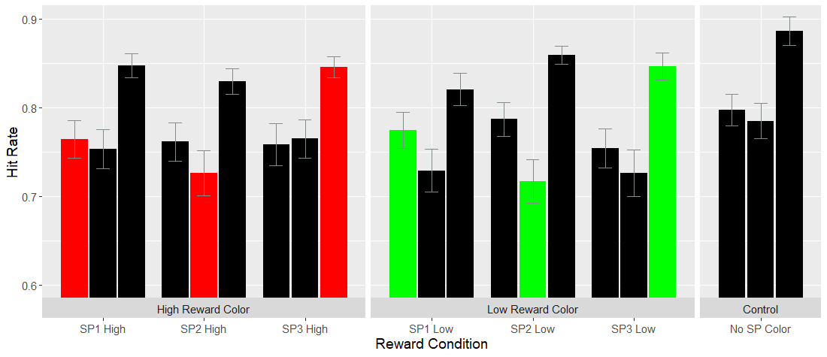
Hit Rate by Reward Condition and Target Position 1100 x 425
Color Value: High Low None

Slide 71
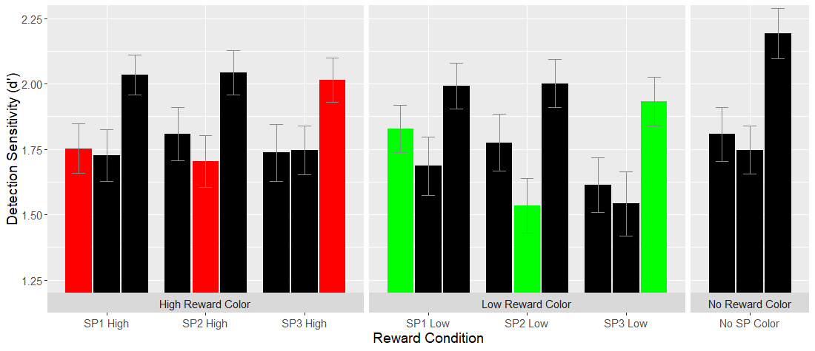
Detection Sensitivity by Reward Condition and Target Position
Color Value: High Low None
Full Stats Here

Slide 72
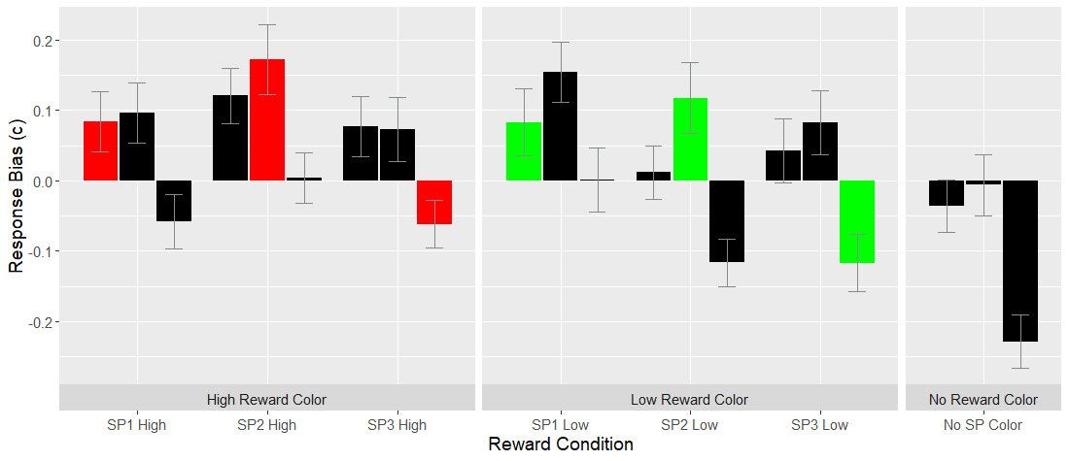
Response Bias by Reward Condition and Target Position
Color Value: High Low None
Full Stats Here

Slide 73
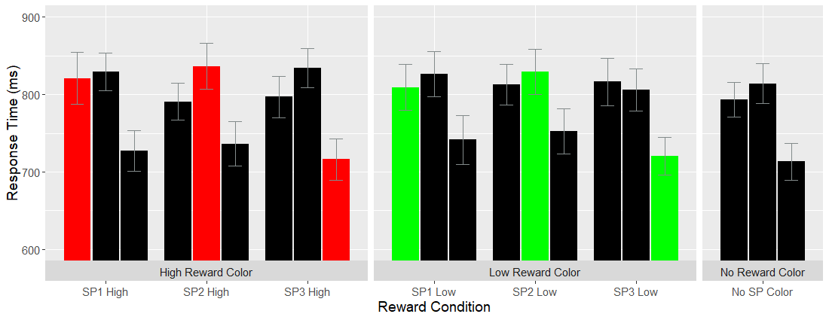
Response Time by Reward Condition and Target Position
Color Value: High Low None
Full Stats Here

Slide 74

Discussion
Effect of reward magnitude on…
Detection Sensitivity | Direct relationship
Response Bias | Inverse relationship
Response Time | Inverse relationship
Notes:
Show example graphs of what we expect from the data – greater d-prime for high-reward items

Slide 75
Limitations
Insufficient trials counts leading to more d’ corrections
Only 5 trials per bin in uncollapsed data set
Greater training required for transfer between less similar tasks
Gong & Li (2014) use upwards of 800 training trials compared to only 200 in the present study
No colored non-reward stimuli to compare as a baseline. The control condition was simply the lack of any color
Notes:
Show example graphs of what we expect from the data – greater d-prime for high-reward items

Slide 76
Questions?

Slide 77
Collapsed Response Statistics
Response Measure | F(2,122) | p | BF
Response Time (ms) | 0.129 | .971 | 0.0618
Discriminability (d’) | 0.402 | .670 | 0.0790
Criterion (c) | 1.784 | .172 | 0.261
Return Here

Slide 78
Detection Sensitivity Comparisons
Comparison |  | F(2,122) | p | BF
SP1 High vs. SP1 Low |  | 0.345 | .709 | .0729
SP2 High vs. SP2 Low |  | 1.928 | .150 | .2959
SP3 High vs. SP3 Low |  | 4.514 | .128* | 2.583
Return Here

Slide 79
Response Bias Comparisons
Comparison |  | F(2,122) | p | BF
SP1 High vs. SP1 Low |  | 3.317 | .039* | 1.04
SP2 High vs. SP2 Low |  | 4.58 | .012* | 3.11
SP3 High vs. SP3 Low |  | 7.184 | .001** | 26.5
Return Here

Slide 80
Response Time Comparisons
Comparison |  | F(2,122) | p | BF
SP1 High vs. SP1 Low |  | 0.637 | .52 | .0952
SP2 High vs. SP2 Low |  | 0.394 | .675 | .0761
SP3 High vs. SP3 Low |  | 0.12 | .887 | .0610
Return Here

